Slide 1

MENTOR
Dr. Geeta Kasana
Associate Professor, CSE

Slide 2
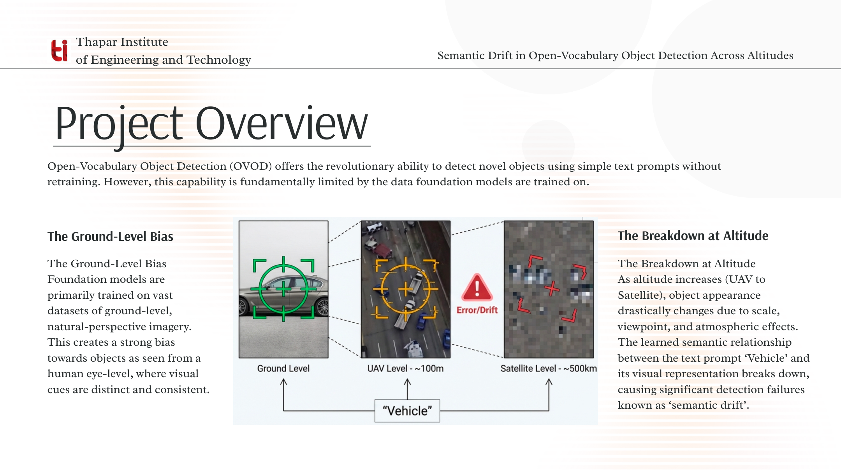

Slide 3
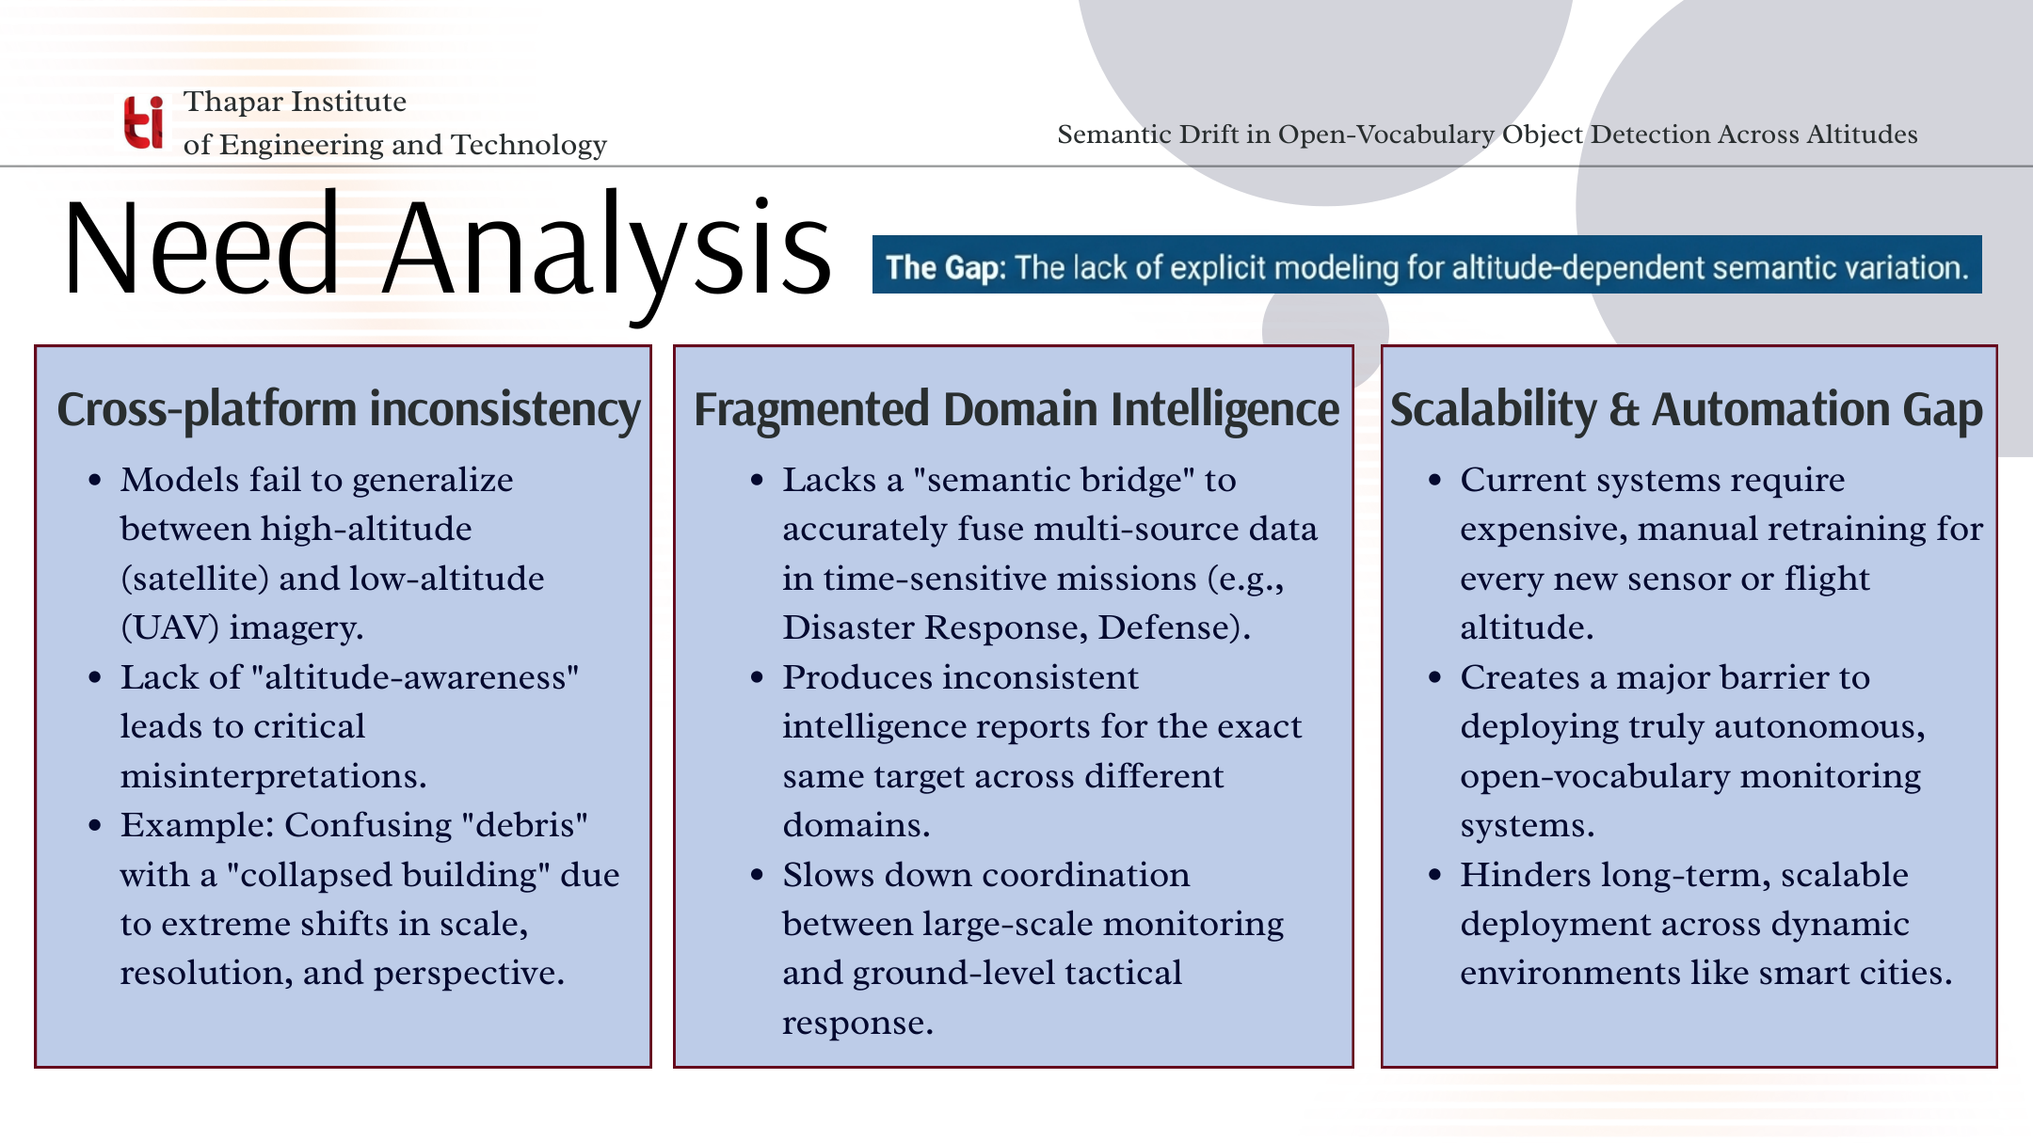

Slide 4
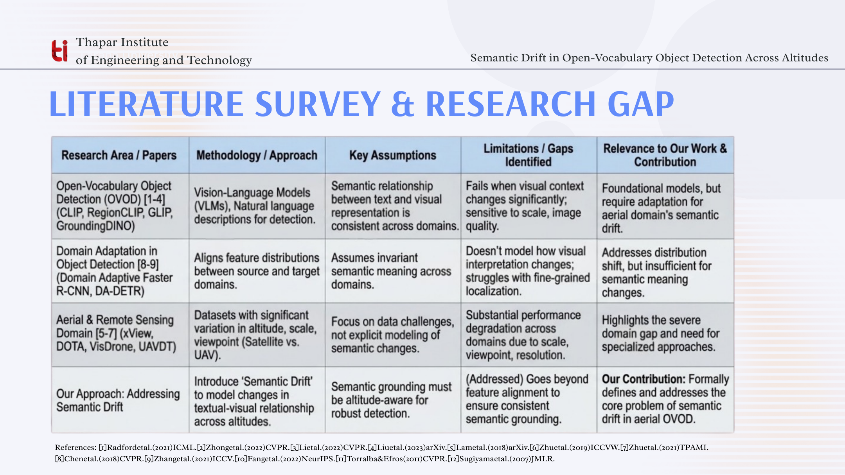

Slide 5
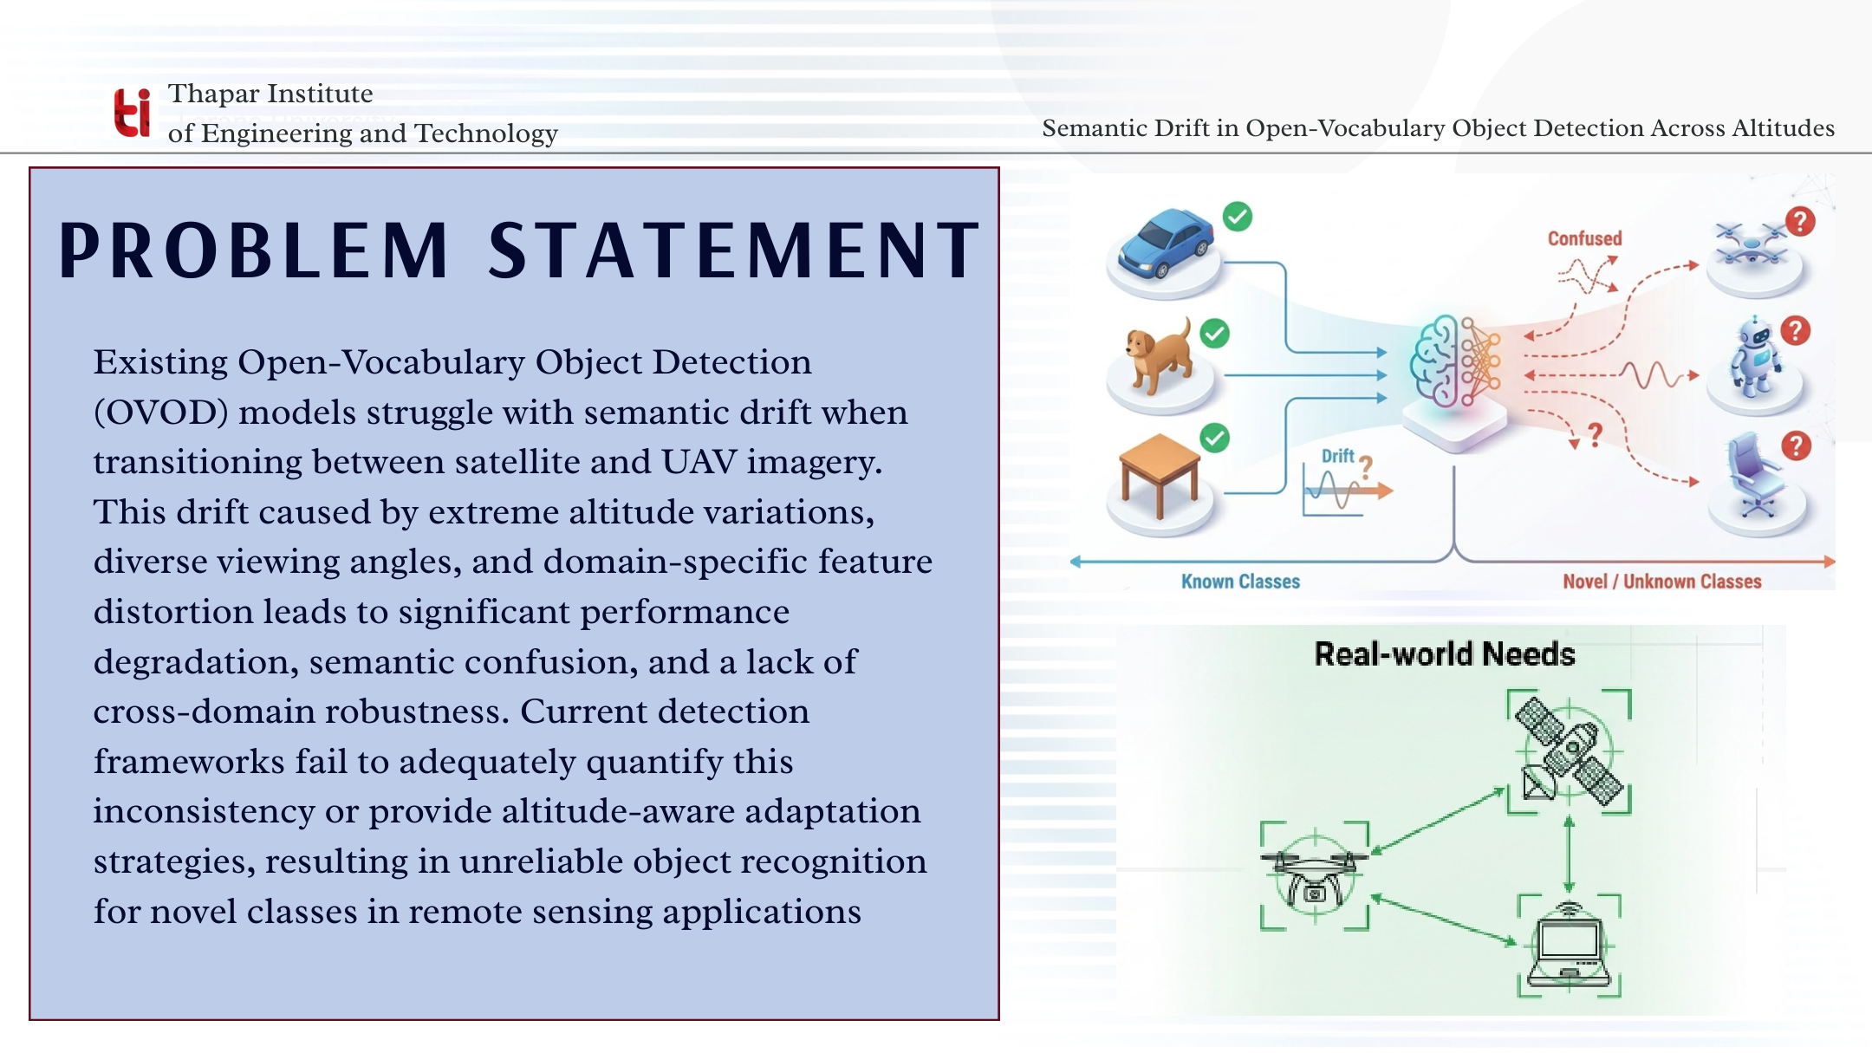

Slide 6
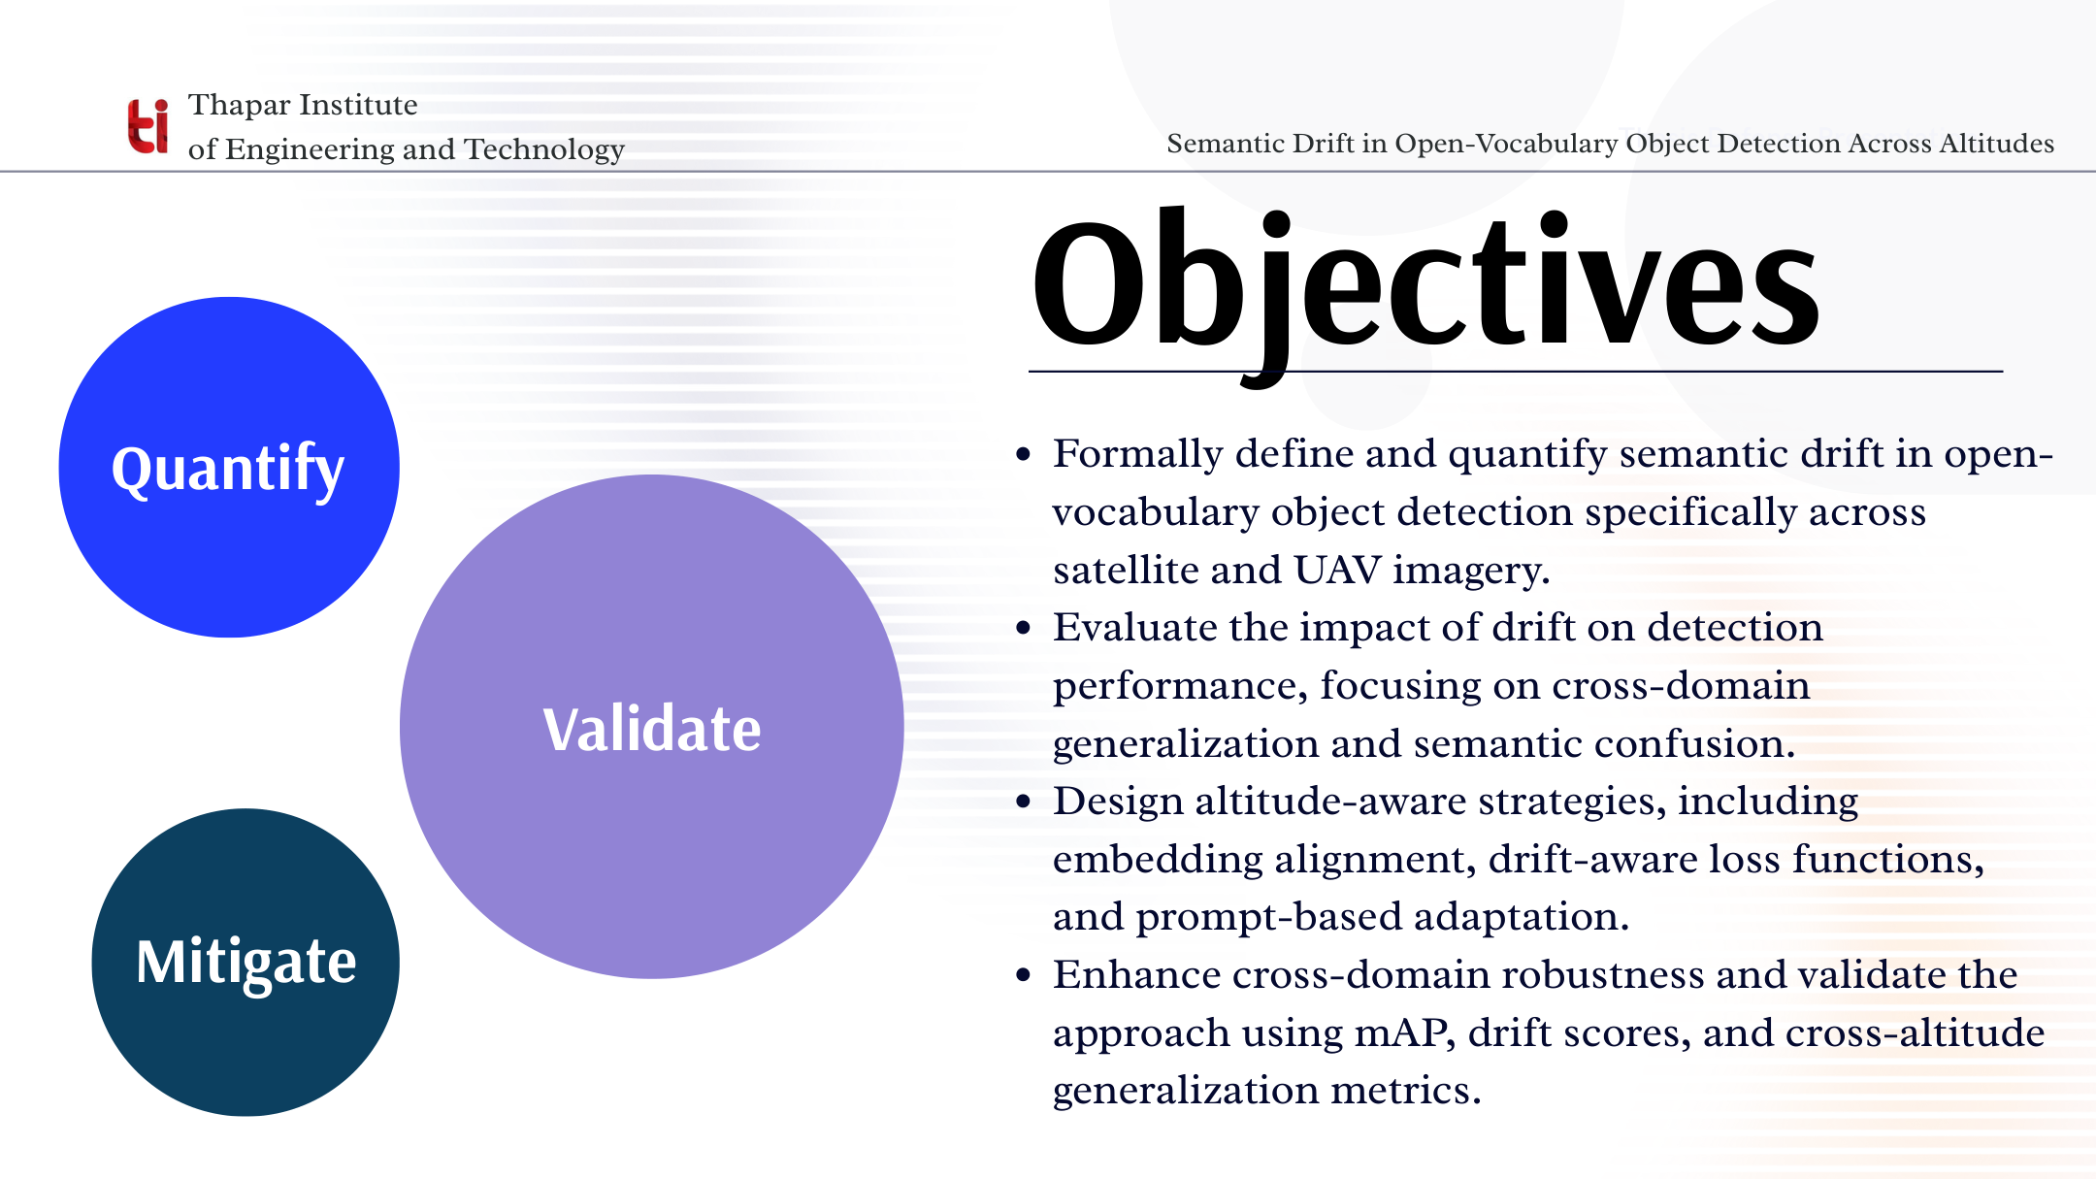

Slide 7
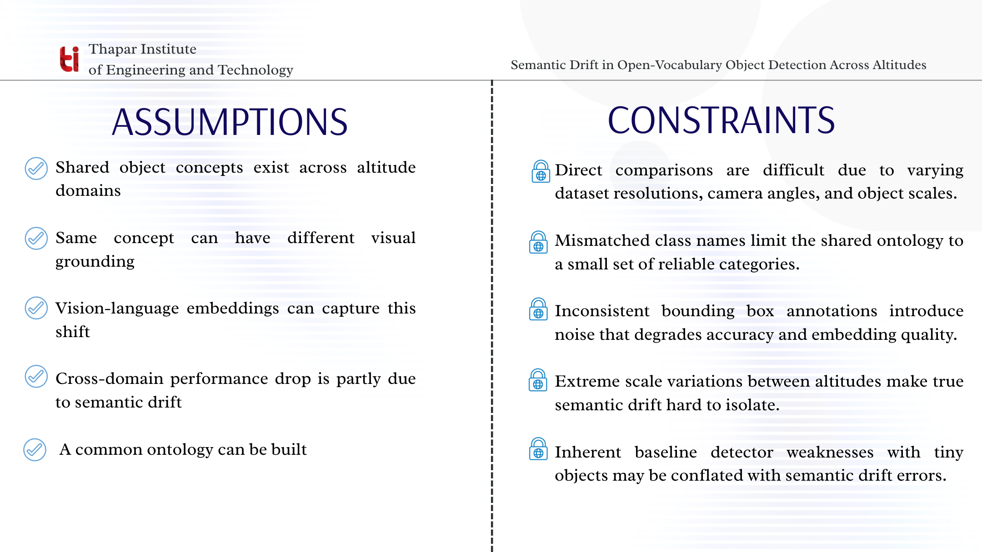

Slide 8
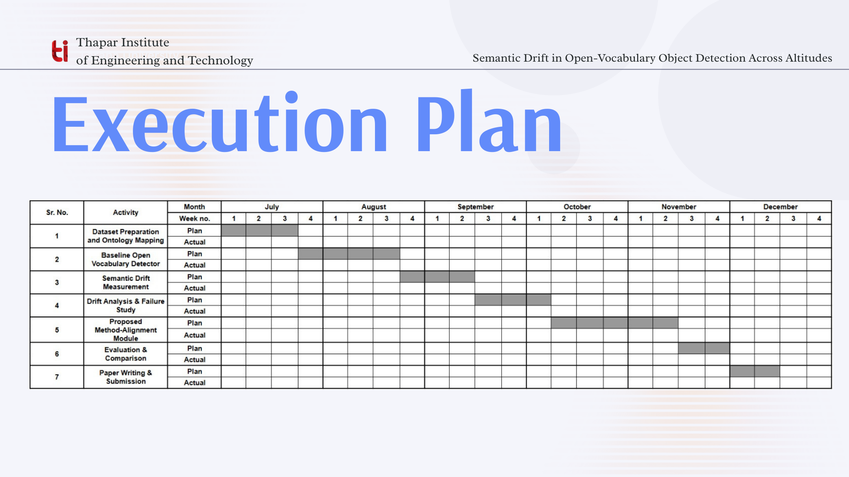
As of Aug 22, 2026

Slide 9
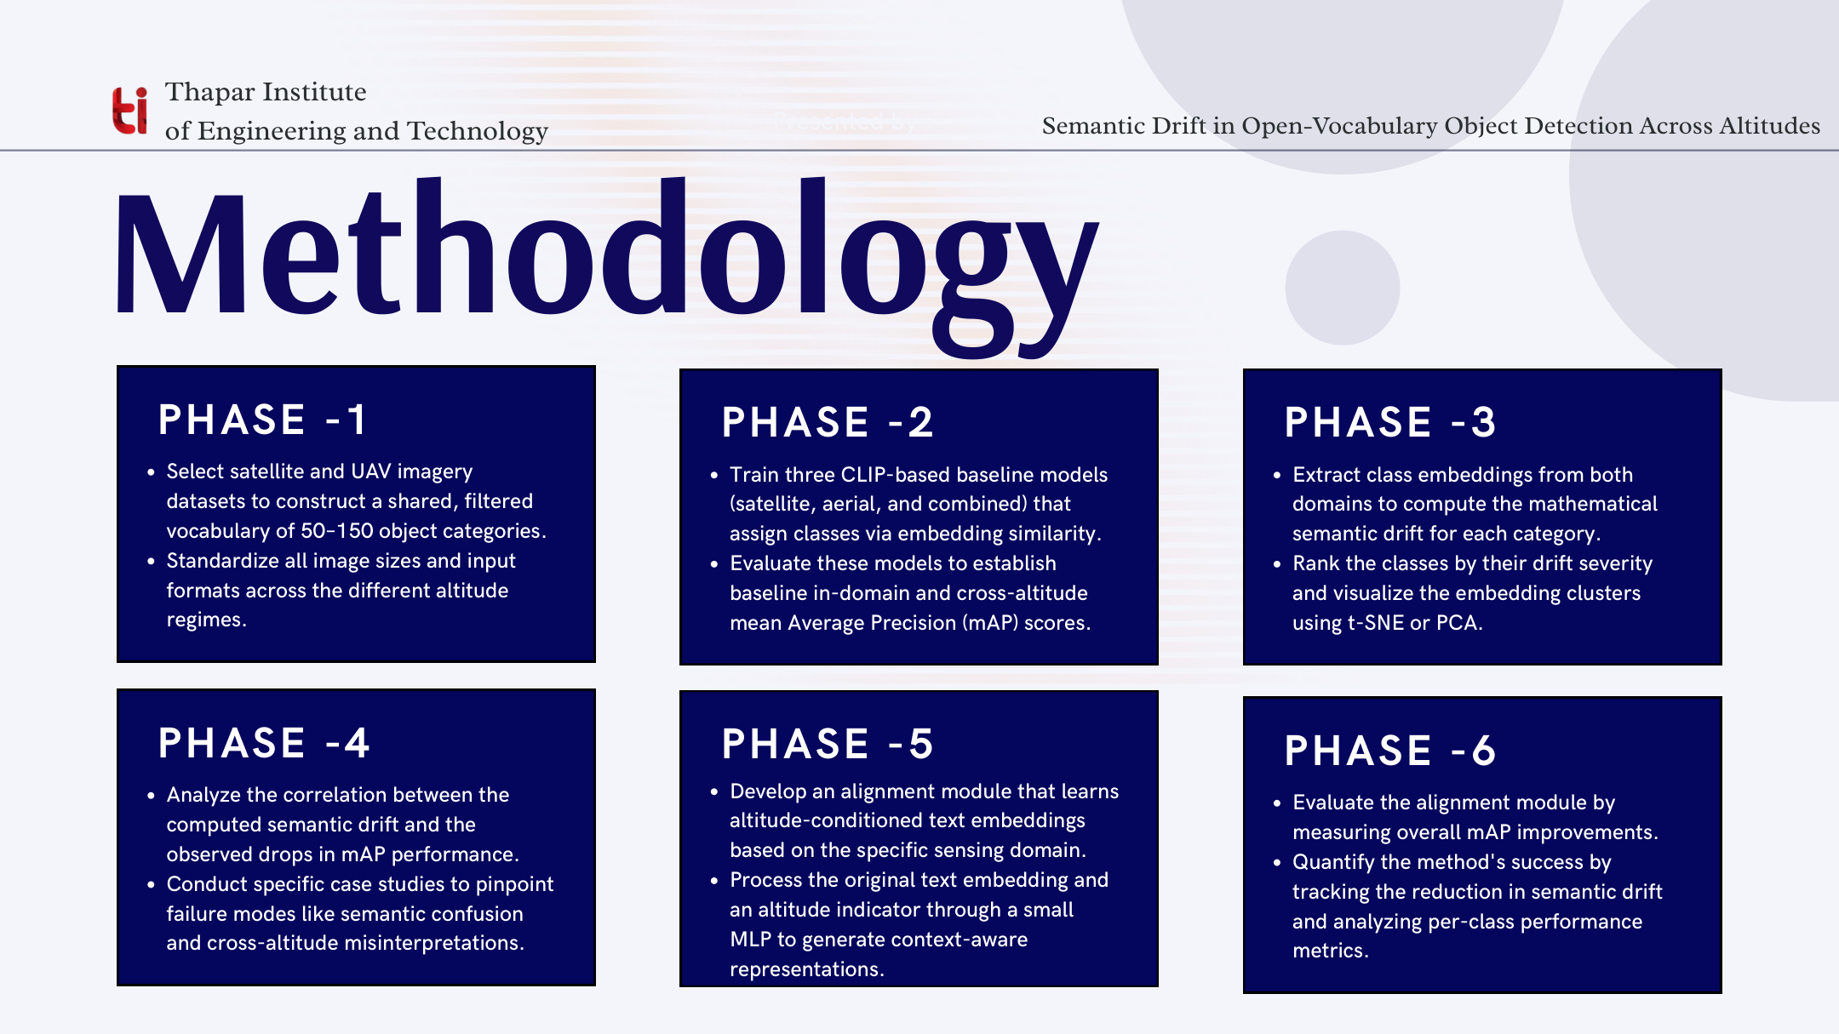

Slide 10
Architecture & Pipeline Design
Overall Architecture — Semantic-Drift Analysis Framework (Fig. 4.1)
CLIP ViT-B/32
(Baseline)
L2 Distance
PCA
DOTA Dataset
(Satellite Domain)
Annotation Processing
+ Common Class Mapping
Ground-Truth Crop Extraction
+ Controlled Class Sampling
RemoteCLIP ViT-L/14
(Baseline)
Embedding Generation
+ Normalization
Class-wise
Aggregation
Cosine Distance
Semantic Drift
Analysis
t-SNE
Experimental
Results
VisDrone Dataset
(UAV Domain)
CLIP
(UAV Fine-Tuned)
Intra-domain
Variation
Heatmap /
Comparison Plot
Experimental Workflow — UML Activity Diagram (Fig. 4.2)
START
Parse Ground-Truth
Annotations
Extract Object
Crops
Select Vision-
Language Model
Encode UAV
Samples
Group Embeddings
by Class
Calculate L2 +
Cosine Drift
Store Experimental
Results
Load DOTA and
VisDrone
Identify Common
Categories
Apply Class-wise
Sampling
Encode Satellite
Samples
Normalize
Embeddings
Calculate Class
Centroids
Generate PCA /
t-SNE / Heatmaps
END

Slide 11
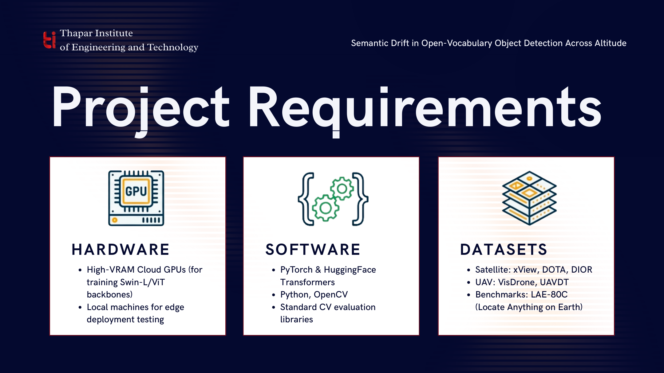
Semantic Drift in Open-Vocabulary Object Detection Across Altitudes
Satellite: DOTA, xView
(streamed)
UAV: VisDrone, UAVid
Historical: Lightning AI
Studio (Phase-1)

Slide 12
Cost Analysis
Category | Details | Estimated Cost
Compute | Lightning AI Studio (Phase-1, cloud credits) + local RTX 3050 Laptop GPU (already-owned hardware) + allotted GPU | TBD
Storage | ~16 GB local disk for datasets, embeddings, checkpoints | $0 (existing hardware)
Data acquisition | DOTA, VisDrone, xView, UAVid — all open academic datasets | $0
Software & tools | PyTorch, HuggingFace Transformers, open_clip, RemoteCLIP — all open-source | $0
Personnel | 5-member student team | Not costed (academic capstone)
From the above breakdown it is clear that this project does not require any major expenses while being an impactful research contribution .

Slide 13
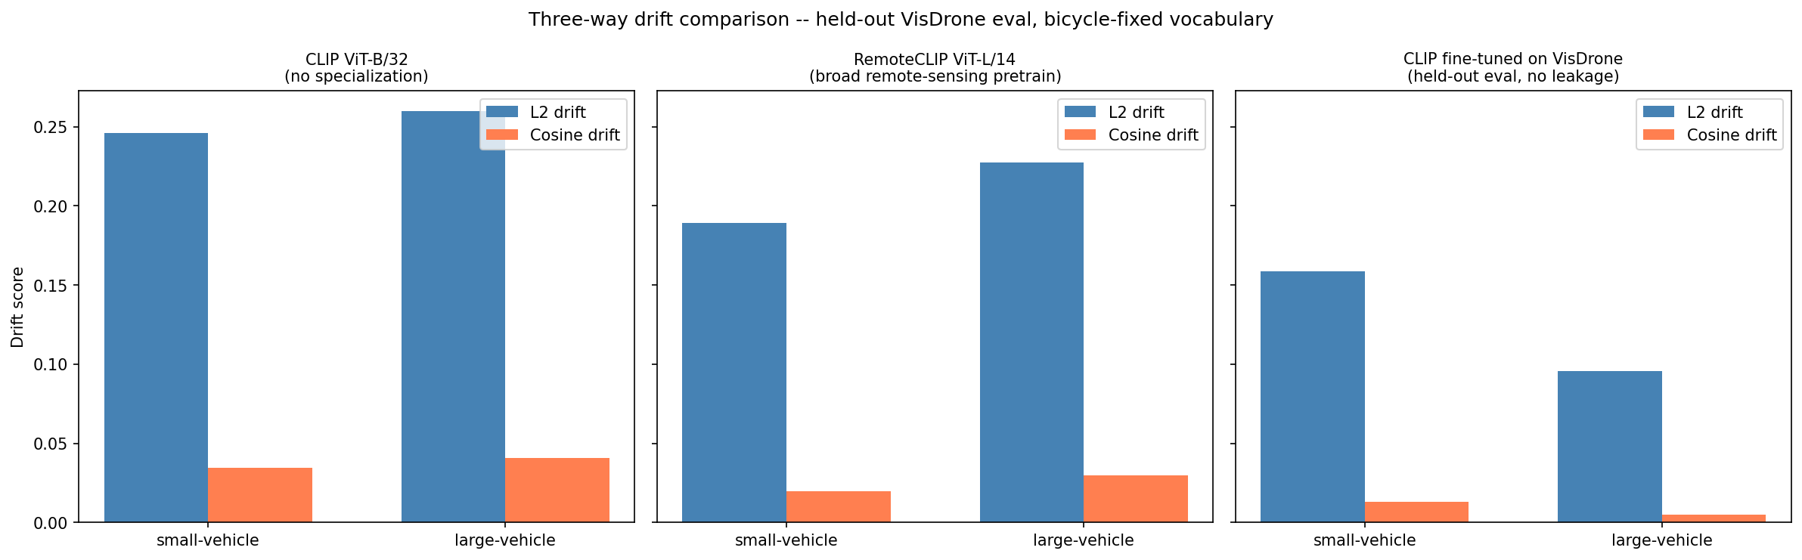
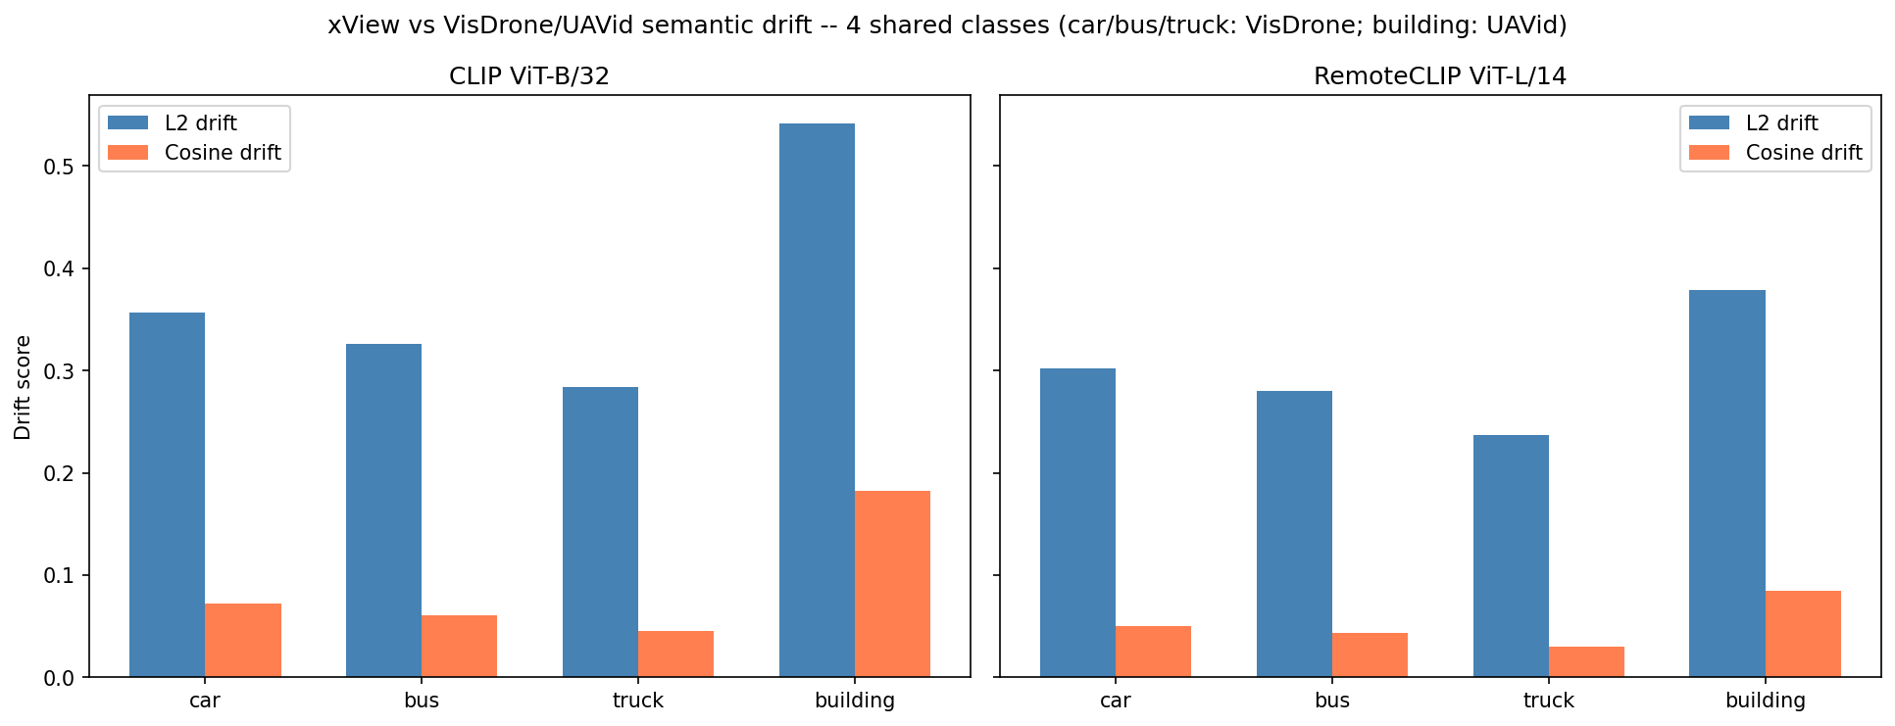
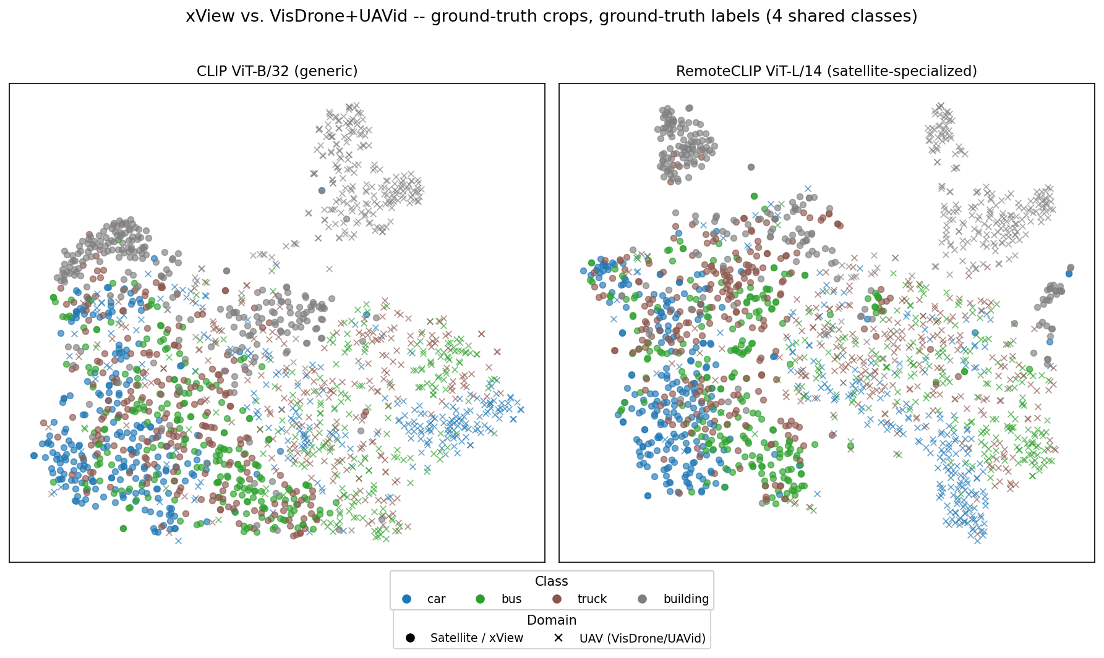
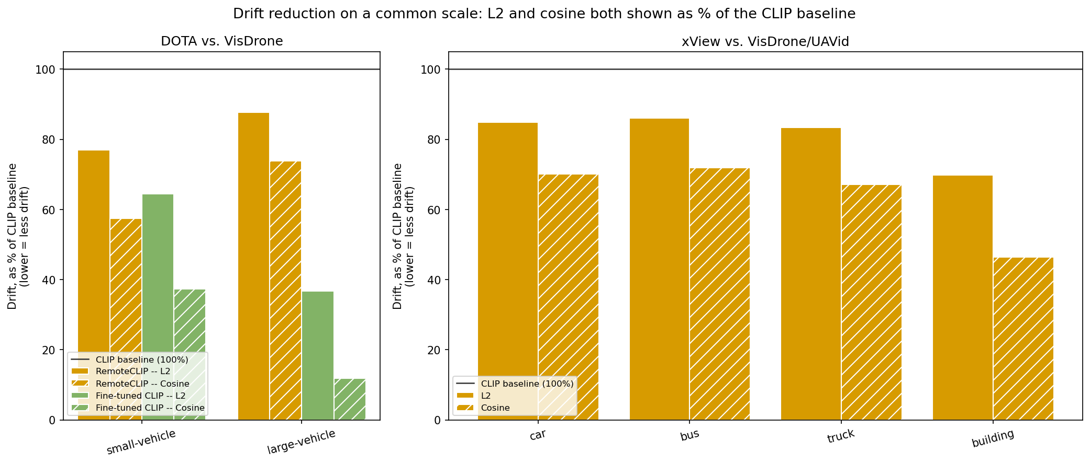
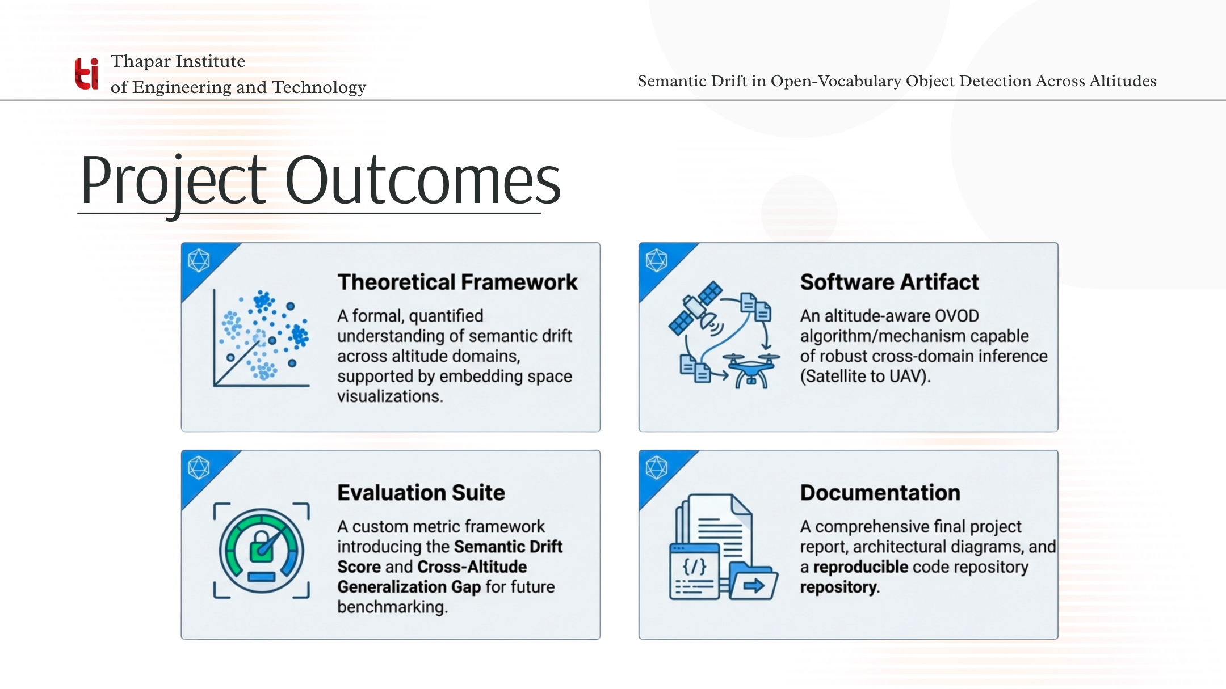
Project Outcomes
DOTA ↔ VisDrone (3-way): RemoteCLIP and our own fine-tuned CLIP both show consistently lower drift than general CLIP, on held-out data with no train/eval leakage.
xView ↔ VisDrone/UAVid (4-class): RemoteCLIP reduces drift on all 4 categories — building shows the largest drift and the largest reduction (30%) of anything measured.
t-SNE, ground-truth crops: the building class forms two visually distinct clusters by altitude — a direct geometric picture of its outsized drift score.
Drift reduction, normalized: L2 and cosine distance on one common scale (% of CLIP baseline) — specialization cuts drift 12–88% across every class and metric tested.

Slide 14
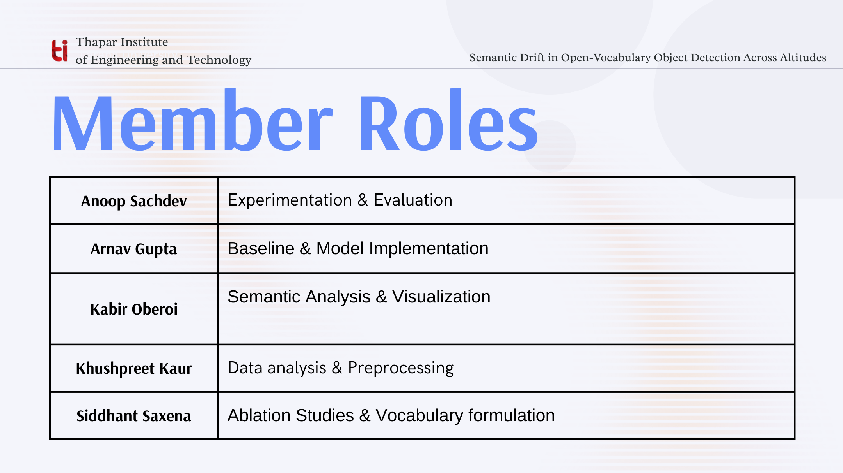

Slide 15
Current Progress & Next Steps
Completion by Approved Phase (Methodology, Sec. 1.8)
• 6 object categories tested
• 2 independent satellite datasets (DOTA, xView)
• 2 independent UAV datasets (VisDrone, UAVid)
• RemoteCLIP reduces drift on ALL 6 categories (12–30%)
Next Steps
• Seed/sample-size robustness check
• Scale to full DOTA / VisDrone / xView
• Phase 4: drift-vs-mAP correlation study
• Phase 5: altitude-conditioned alignment module
• Phase 6: mAP + cross-altitude gap evaluation
• Integrate with teammate's SAM-based detection pipeline

